Slide 1

SHABNAM GHAREH MOHAMMADLOU 40239861 SEPEHR GHAMARI 40273405 ALA KERAMATI 40255113
Ultrasound Elastography:
A Dynamic Programming Approach
November 2023

Slide 2
Overview
Introduction
Objective
Methodology
Results
References

Slide 3

Introduction
Overview of Elastography using ultrasound images
Elastography is a technique that measures the elasticity or stiffness of tissues to assess and diagnose various conditions.
liver fibrosis
breast tumors,…
Challenges in Elastography
Signal decorrelation between precompression and postcompression images
Displacement estimation requires large windows accuracy for RF data.
Variance reduction
Compression tolerance limit
Computationally expensive and unsuitable for real-time

Slide 4
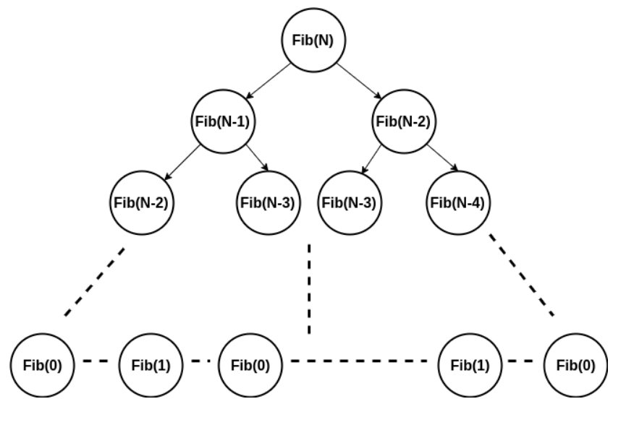
Objective
In this project we use dynamic programming to calculate strain images of the tissues in real time applications.
Dynamic Programming (DP):
An optimization algorithm that breaks down complex problems into smaller overlapping subproblems, solving each subproblem only once and storing its solution for future reference, making decisions iteratively to efficiently optimize a cost function.
Memozing:
Useful in problems with overlapping subproblems, where the same subproblems are solved multiple times. By memorizing solutions, DP avoids redundant work and significantly improves the efficiency of the algorithm.

Slide 5
Methodology
Calculate Displacement Map
Displacement maps track the movement of pixels between images captured before and after tissue compression. Calculate displacement map by optimizing cost function using DP.
2. Generate Strain Images
Strain images, calculated from these displacement maps, provide insights into the deformation of soft tissues.
Calculate strain images based on LSQ method [1]
3. Results from 1D and 2D:
Obtain results from both 1D and 2D elastography techniques
4. Comparison
Compare the results obtained from the displacement map and strain images

Slide 6
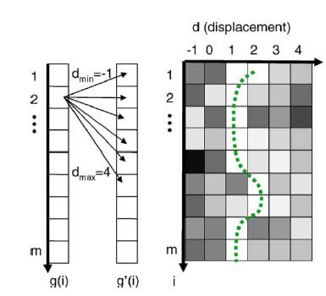
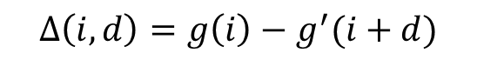
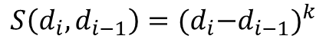
One-Dimensional displacement method
1D displacement:
Analyzing echo signals before and after compression
calculating the displacement of each pixels along axial directions
- considering precompression and postcompression image
- minimizing the cost function
Cost function:
Memoized:
$$C\left(i, d_{i}\right)=\min_{d_{i−1}}\left\{C\left(i−1,d_{i−1}\right)+ωS(d_{i}, d_{i−1})\right\}+∆(i, d_{i})$$
$$S\left(d_{i}, d_{i−1}\right)={{(d}_{i}−d_{i−1})}^{k}$$
$$∆\left(i, d\right)=g\left(i\right)−g^{′}(i+d)$$
$M(i,d_{i}$)= arg$\min_{d_{i−1}}\left\{C\left(i−1,d_{i−1}\right)+ωS(d_{i}, d_{i−1})\right\}$

Slide 7
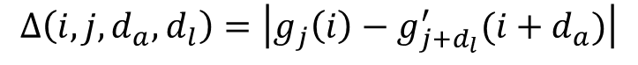
two-Dimensional displacement method
2D Displacement
Calculate each pixel’s displacements in both axial and lateral dimensions
All the displacement and smoothness and cost function change accordingly
Cost function:
$C_{j}\left(d_{a}, d_{l}, i\right)=∆\left(d_{a}, d_{l}, i\right)+\begin{matrix}min \\ δ_{a}, δ_{l}\end{matrix}\left\{\frac{C_{j}\left(δ_{a}, δ_{l}, i−1\right)+C_{j−1}\left(δ_{a}, δ_{l}, i\right)}{2}+ωS({d_{a}, d_{l},δ}_{a}, δ_{l})\right\}$
$$∆\left(i, j, d_{a},d_{l}\right)=\left|g_{j}\left(i\right)−g_{j+d_{l}}^{′}(i+d_{a})\right|$$
$$S\left(d_{a_{i}}, d_{l_{i}}, d_{a_{i−1}}, d_{l_{i−1}}\right)={{(d}_{a_{i}}−d_{a_{i−1}})}^{2}+{{(d}_{l_{i}}−d_{l_{i−1}})}^{2}$$

Slide 8
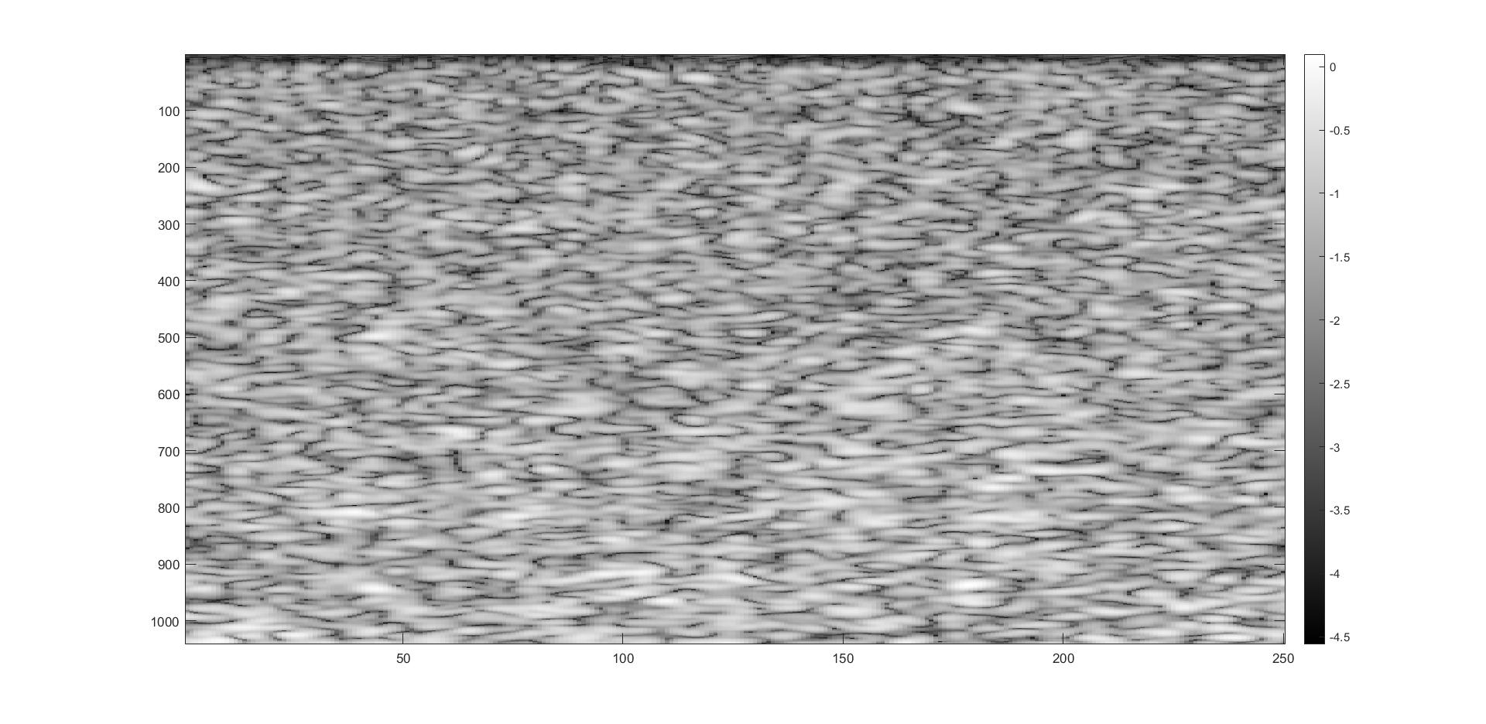
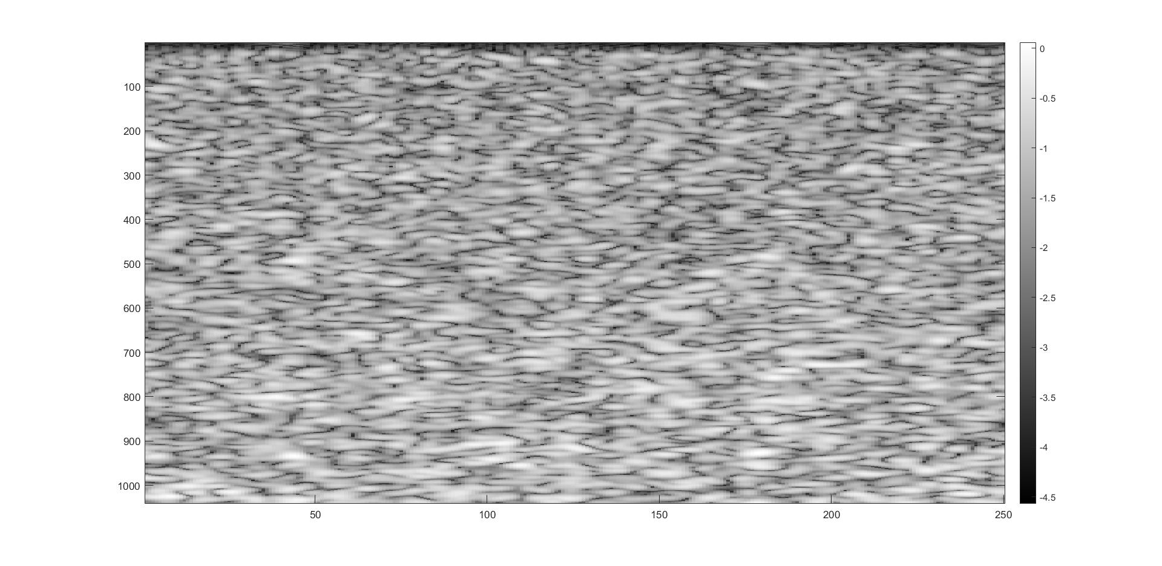
Experiment
For experimental evaluation, RF data was acquired from an Antares Siemens system (Issaquah, WA) with a 7.27-MHz linear array at a sampling rate of 40 MHz. [1]
RF Data Before Compression
RF Data After Compression

Slide 9
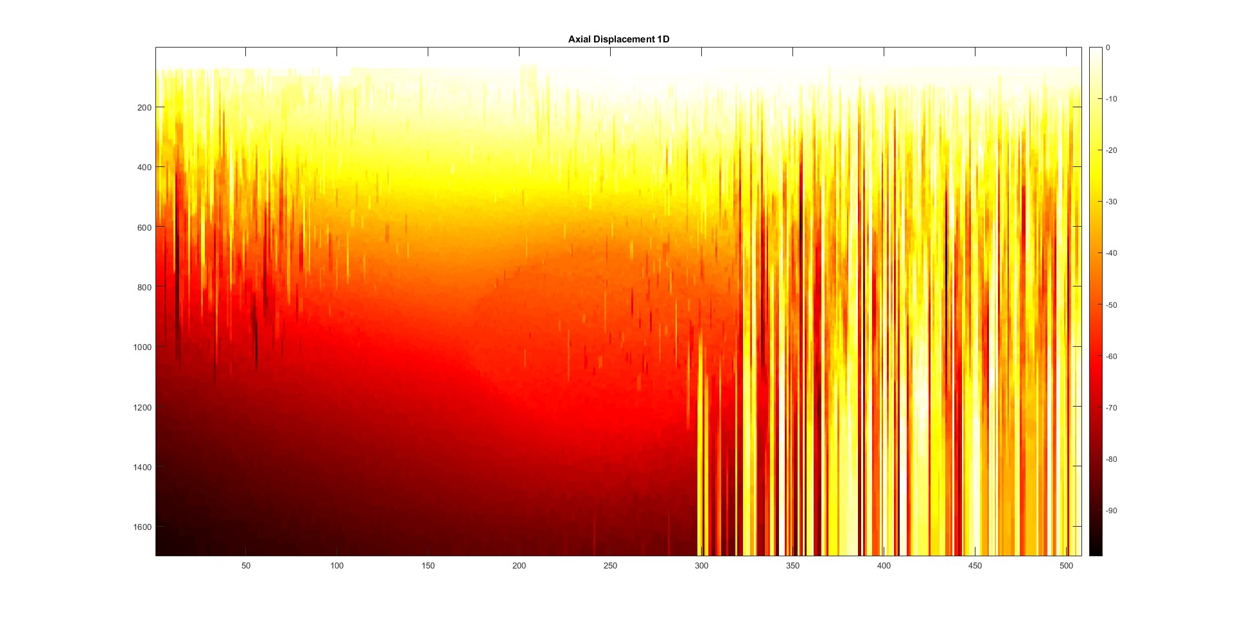
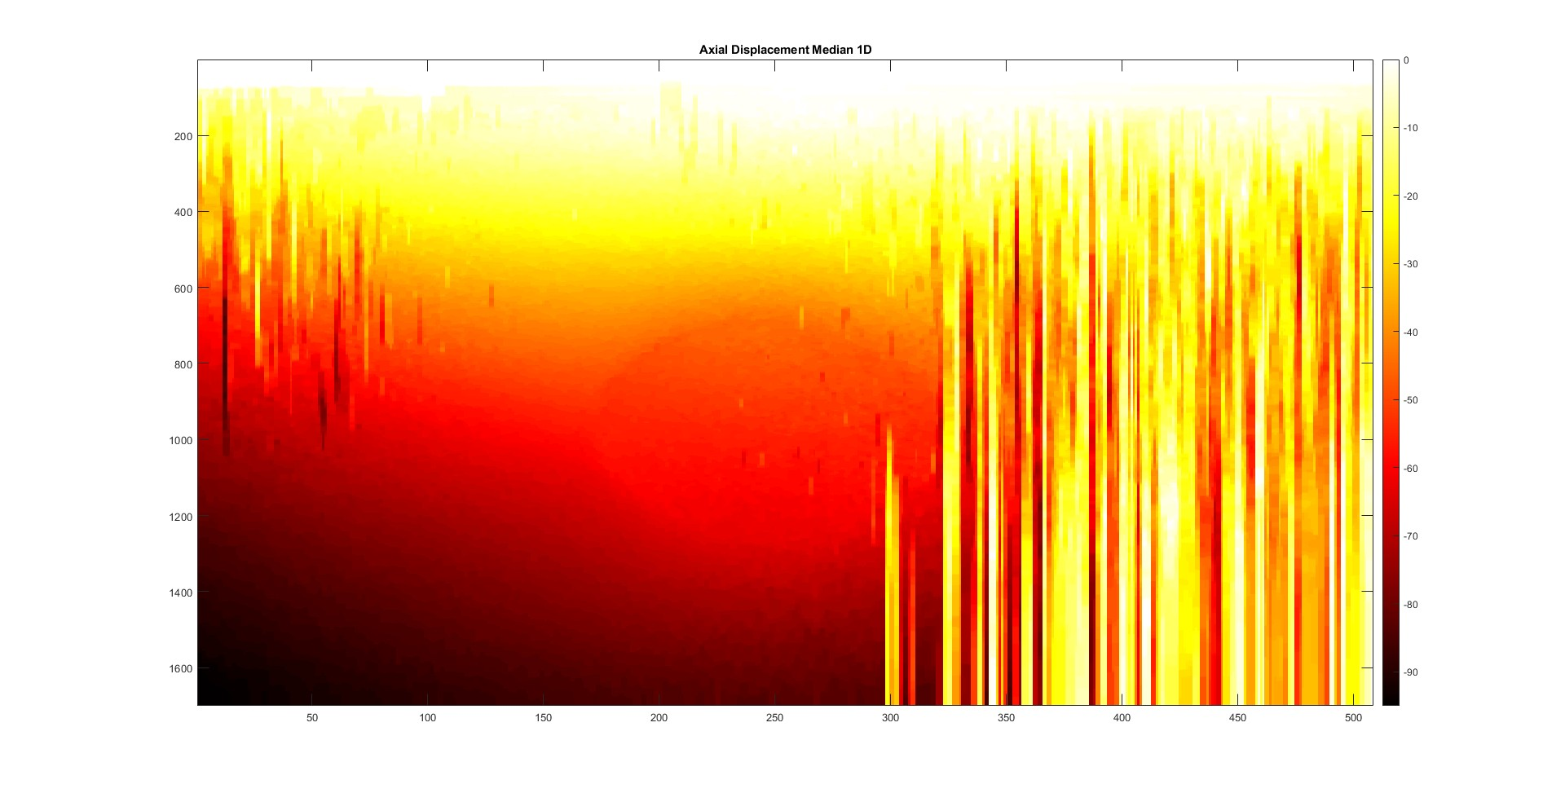
1D displacement results
Hyper parameters: W=0.15
Axial displacement= [-100, -99, …, 0]
Minimization window size= 3
Axial Displacement
Axial Displacement + Median Filter

Slide 10
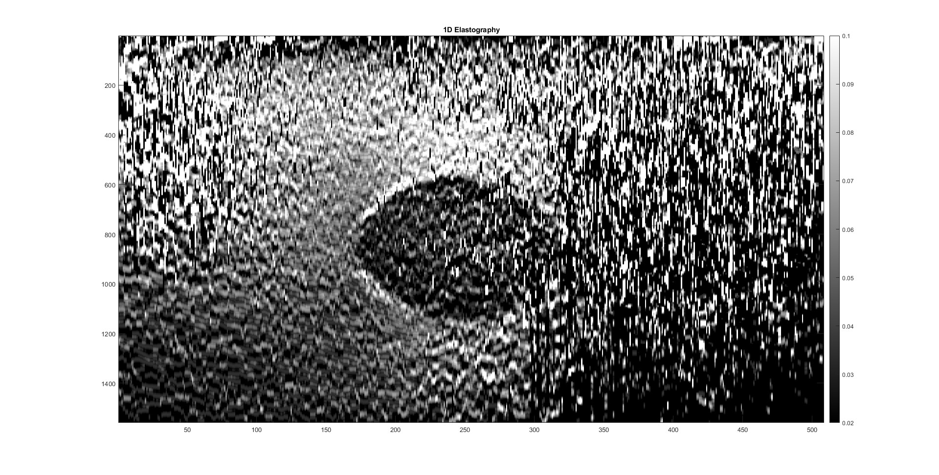
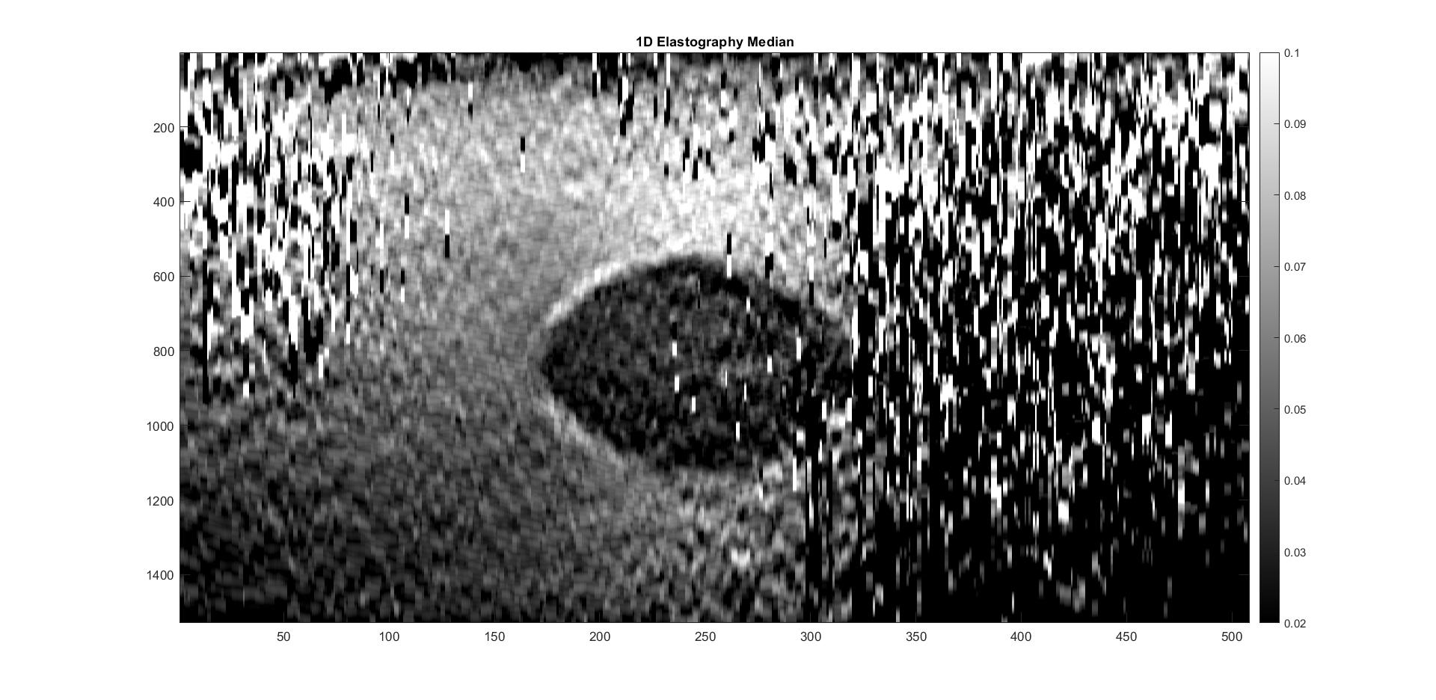
1D Strain results
Strain Image
Window size = 43
Strain Image
Window size = 73

Slide 11
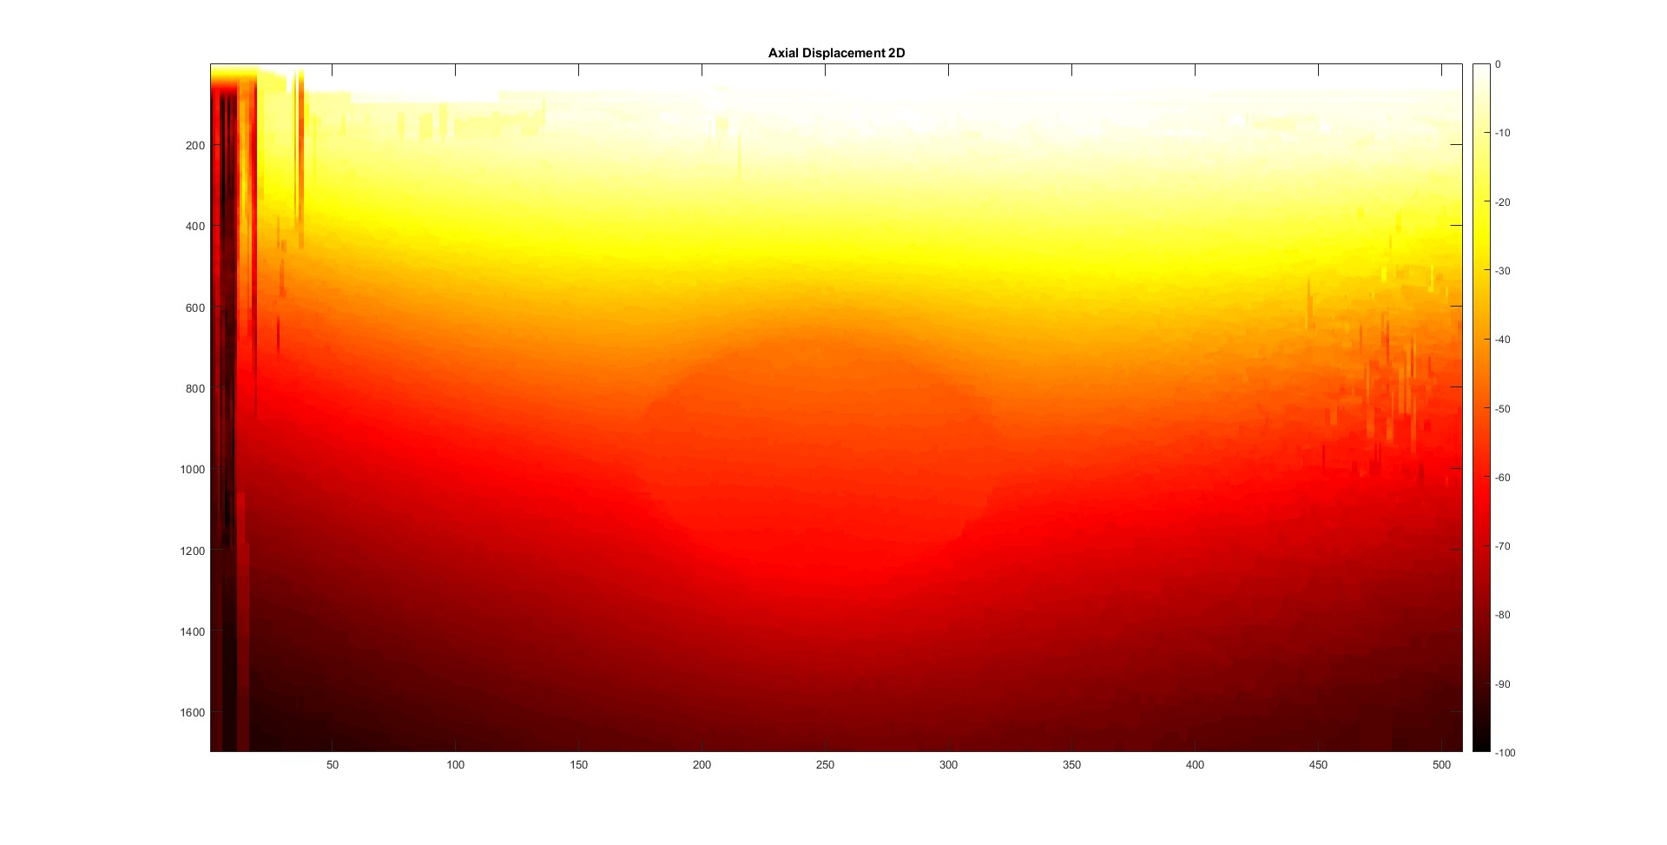

2D displacement results
Hyper parameters: W=0.15
Axial displacement= [-100, -99, … , 0]
Lateral displacement= [-4,-3,…,4]
Minimization window size= 3
Axial Displacement
Axial Displacement + Median Filter

Slide 12
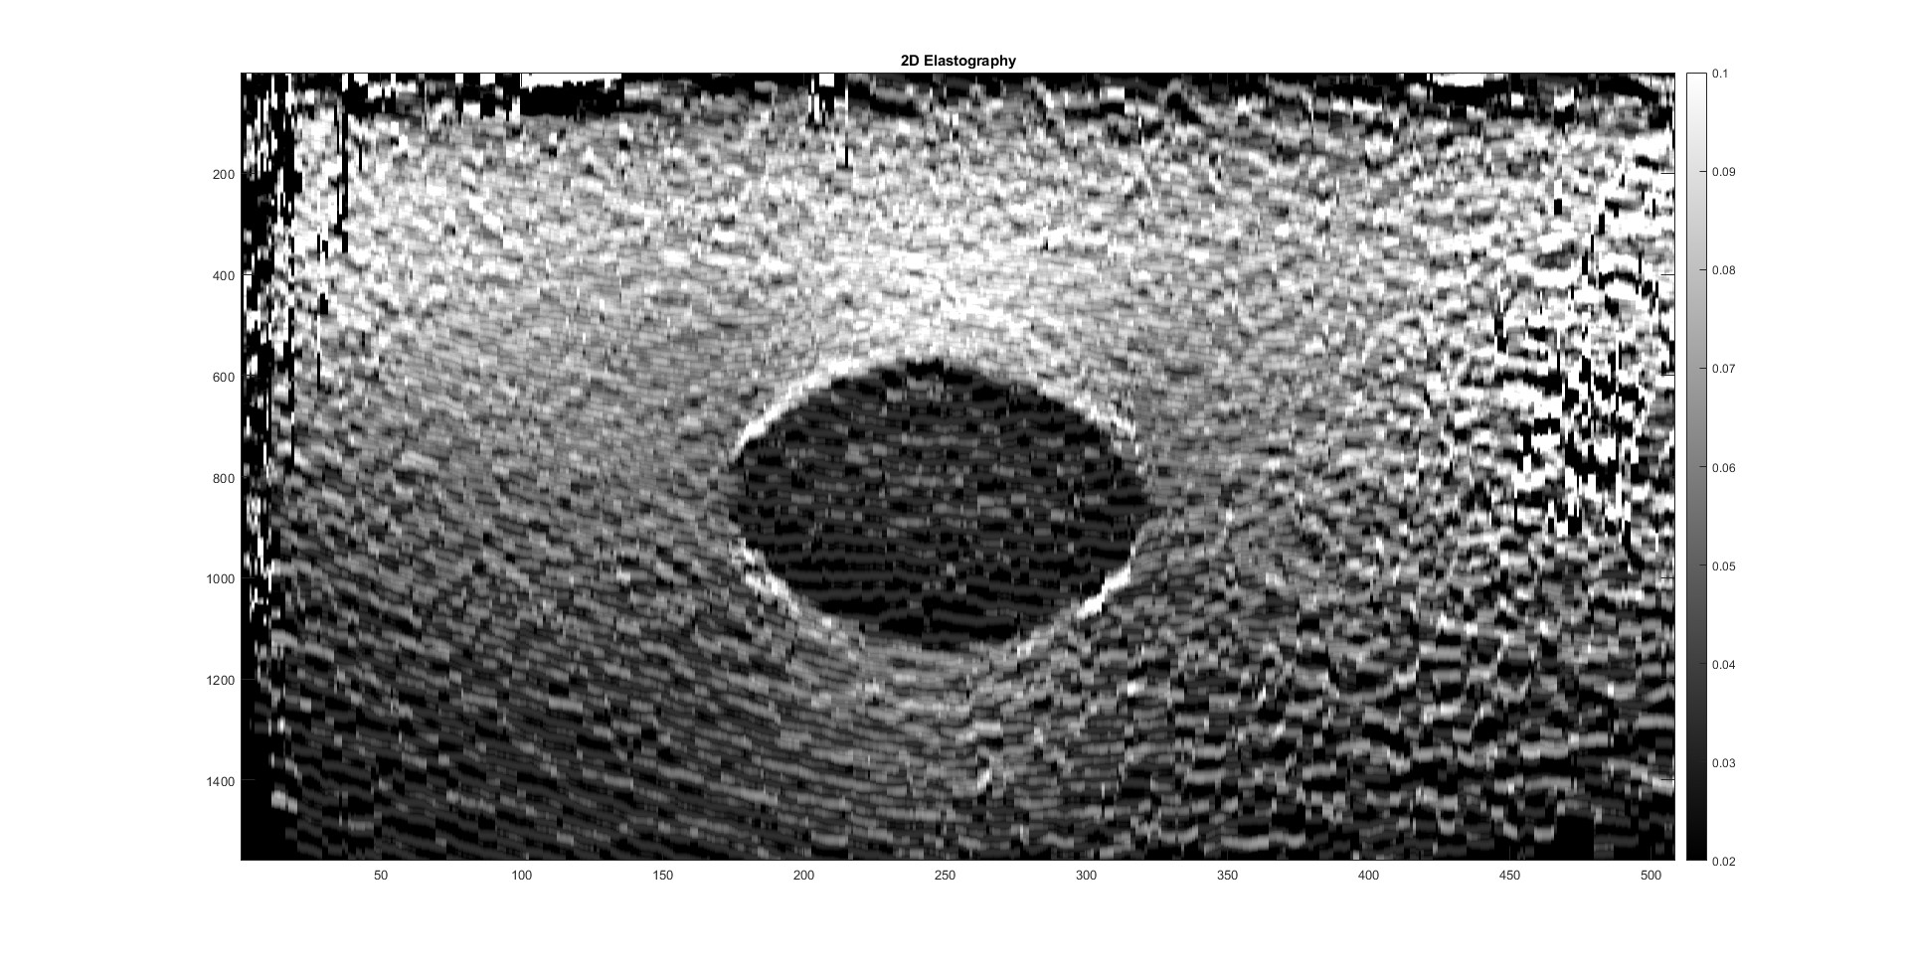
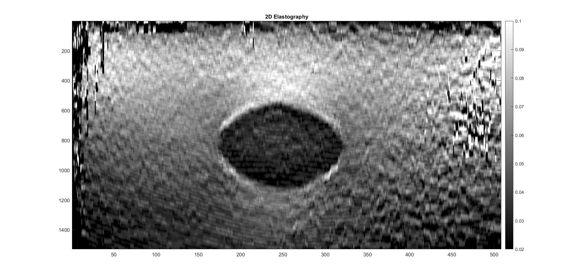
2D Strain results
Strain Image
Window size = 43
Strain Image
Window size = 73

Slide 13
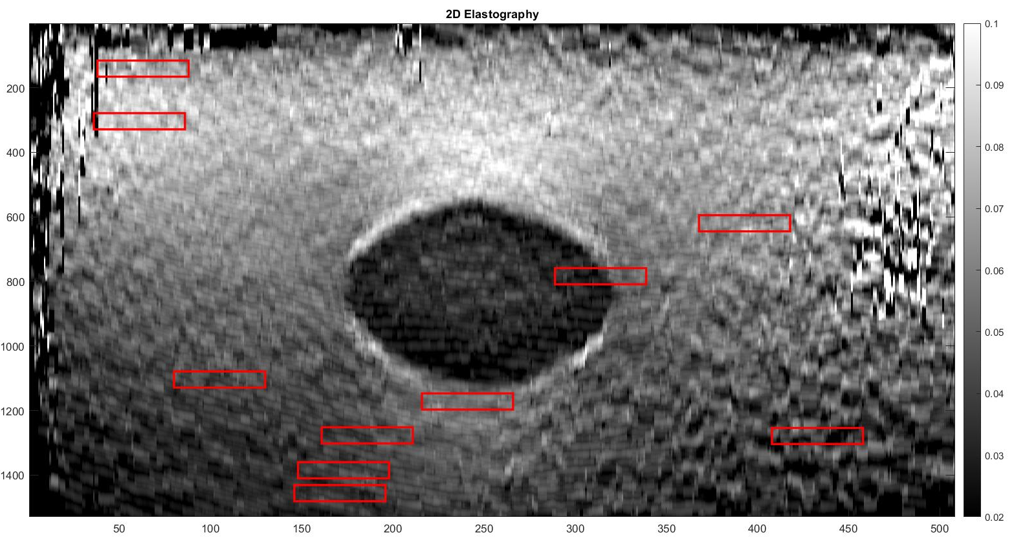
SNR
 | SNR
1D DP | 40.5892
1D DP + Median | 47.5327
2D DP | 63.9497
2D DP + Median | 66.4052
SNR Window Selection
10 windows
Result

Slide 14
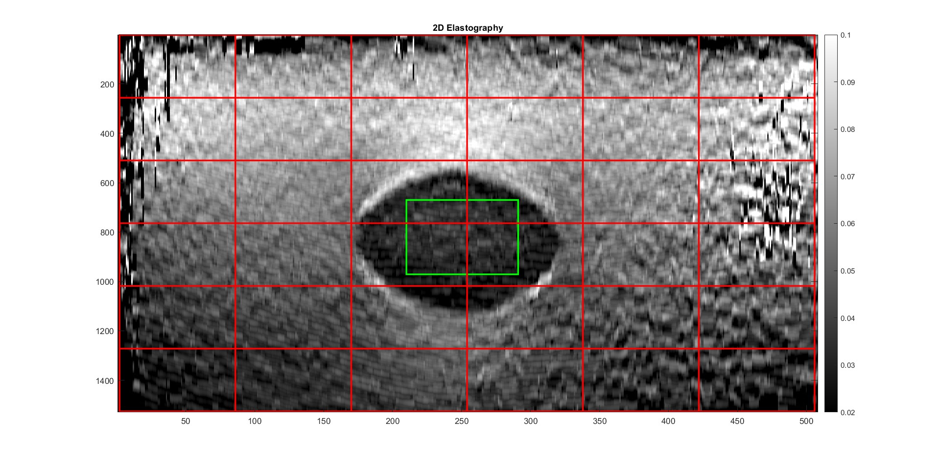
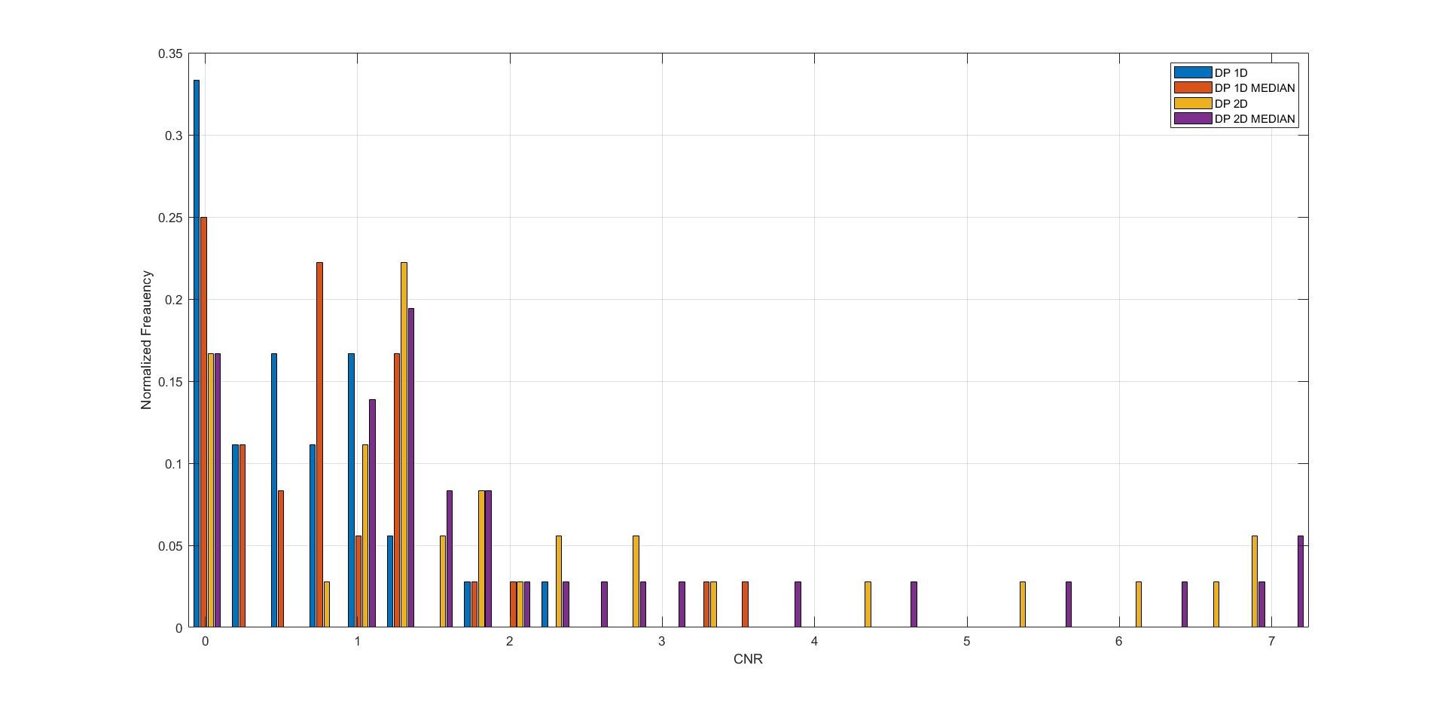
cnr
CNR Target Window & Background Window Selection
36 windows
CNR Compression
1D DP | 1D DP + Median | 2D DP | 2D DP + Median
0.6750 | 0.9299 | 2.2169 | 2.3127

Slide 15
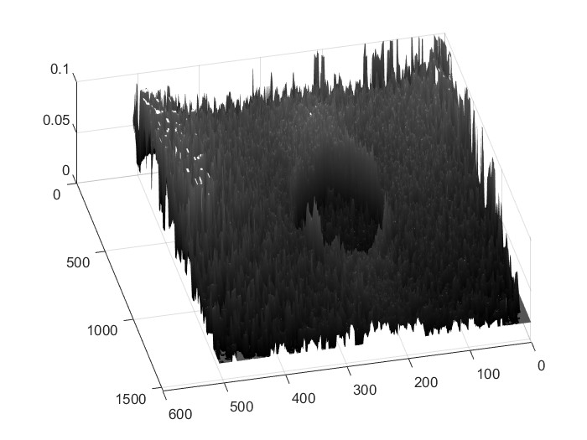
3-D Visualization of 2-D strain

Slide 16
Our challenges
Low speed run time
Strain calculation
Tuning hyperparameters (da, dl, w,…)

Slide 17

Reference
[1] https://users.encs.concordia.ca/~hrivaz/Ultrasound_Elastography/
[2] Ultrasound Elastography: A Dynamic Programming Approach
Hassan Rivaz*, Emad Boctor, Pezhman Foroughi, Richard Zellars, Gabor Fichtinger, and Gregory Hager
[3] H. Rivaz, Boctor, E., Choti, M., Hager, G., Real-Time Regularized Ultrasound Elastography, IEEE Trans. Medical Imaging, April 2011, vol. 30 pp 928-945

Slide 18

Thank you

